Slide 1


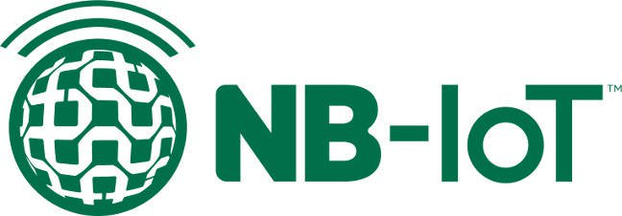
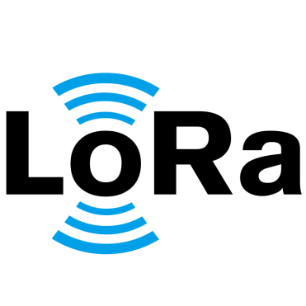


15CSE480 Internet of Things Lecture -8
Dr. V Anantha Narayanan
Mr A Baskar
Mr A K Sumesh (Mentor)
Dept. of CSE.,
ASE, Coimbatore

Slide 2
IoT Levels and Deployment Templates

Slide 3
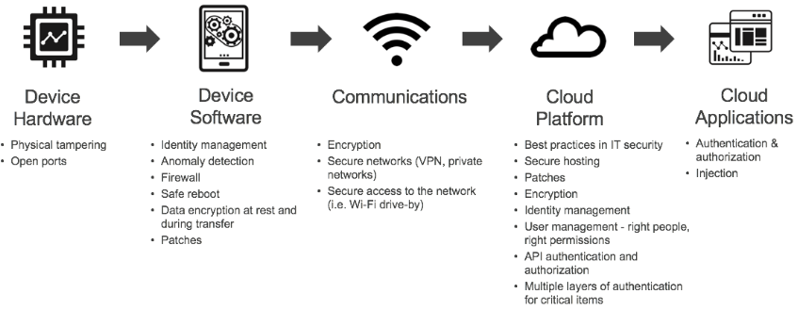
Summary of IoT Stack

Slide 4
IoT Levels and Deployment Templates
An IoT system comprises the following components:
Device, Resource, Controller Service, Database, Web service, Analysis Component and Application.
Device :
An IoT device allows identification, remote sensing, remote monitoring capabilities.
Resource:
Software components on the IoT device for
-accessing, processing and storing sensor information,
-controlling actuators connected to the device.
- enabling network access for the device.
Controller Service:
Controller service is a native service that runs on the device and interacts with the web services.
It sends data from the device to the web service and receives commands from the application (via web services) for controlling the device.

Slide 5
Database:
• Database can be either local or in the cloud and stores the data generated by the IoT device.
Web Service:
•Web services serve as a link between the IoT device, application, database and analysis components.
•It can be implemented using HTTP and REST principles (REST service) or using theWebSocket protocol (WebSocket service).
Analysis Component:
• Analysis Component is responsible for analyzing the IoT data and generating results in a form that is easy for the user to understand.
Application:
• IoT applications provide an interface that the users can use to control and monitor various aspects of the IoT system.
• Applications also allow users to view the system status and the processed data.

Slide 6
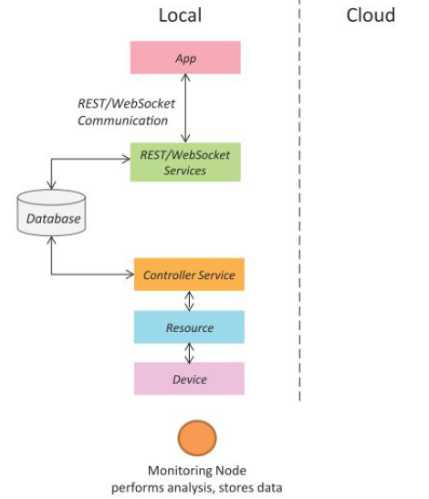
IoT Level-1
A level-1 IoT system has a single node/device that performs sensing and/or actuation, stores data, performs analysis and hosts the application
Level-1 IoT systems are suitable for modeling low cost and low-complexity solutions where the data involved is not big and the analysis requirements are not computationally intensive.

Slide 7
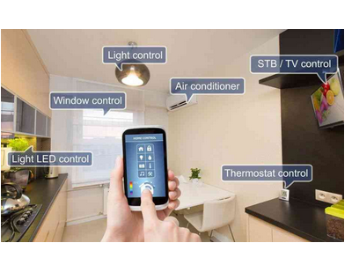
IoT – Level 1 Example : Home Automation System

Slide 8
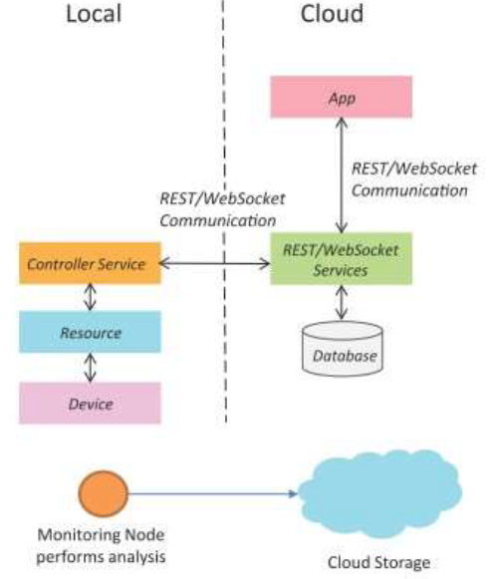
IoT Level-2
A level-2 IoT system has a single node that performs sensing and/or actuation and local analysis. Data is stored in the cloud and the application is usually cloud-based.
Level-2 IoT systems are suitable for solutions where the data involved is big; however, the primary analysis requirement is not computationally intensive and can be done locally.

Slide 9
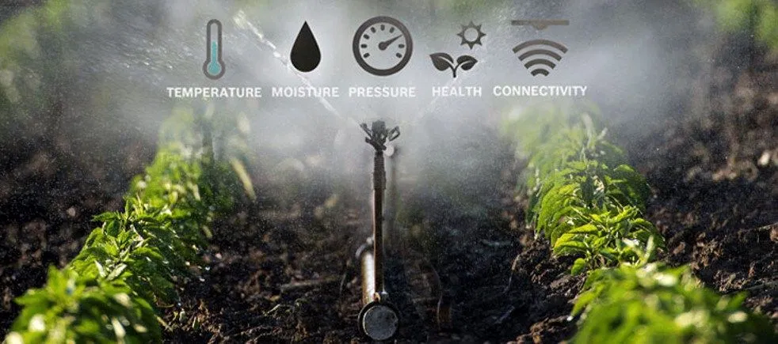
IoT – Level 2 Example: Smart Irrigation

Slide 10
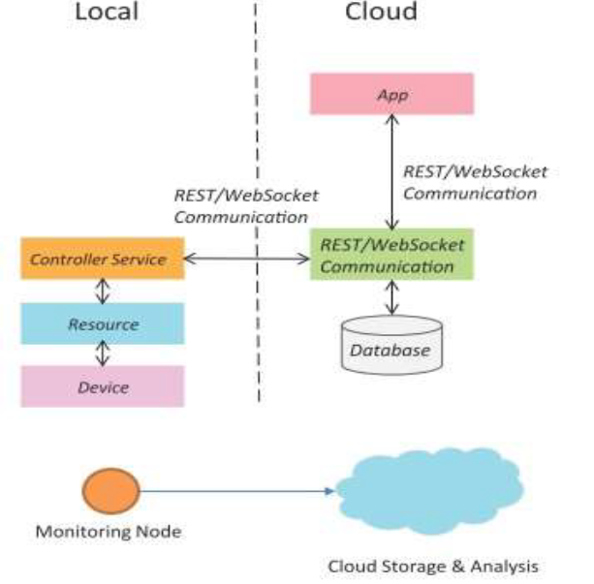
IoT Level-3
A level-3 IoT system has a single node. Data is stored and analyzed in the cloud and the application is cloud based.
Level-3 IoT systems are suitable for solutions where the data involved is big and the analysis requirements are computationally intensive.

Slide 11
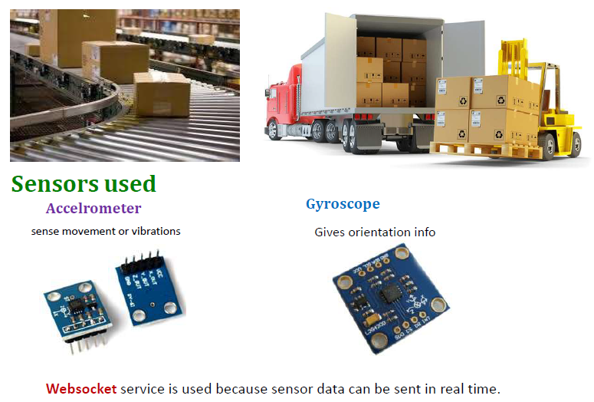
IoT – Level 3 Example: Tracking Package Handling

Slide 12
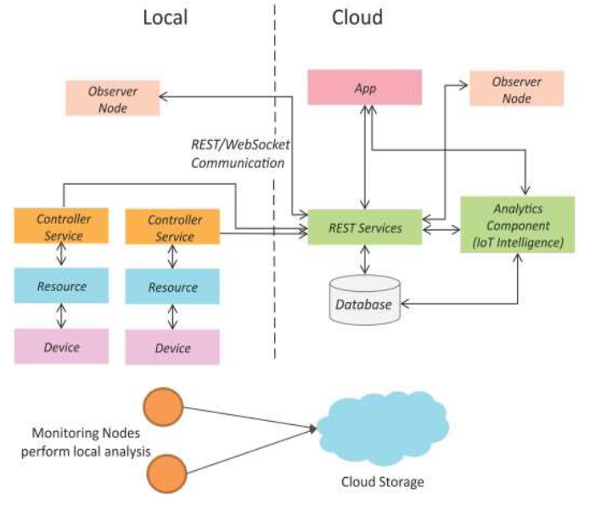
IoT Level-4
A level-4 IoT system has multiple nodes that perform local analysis. Data is stored in the cloud and the application is cloud-based.
Level-4 contains local and cloud based observer nodes which can subscribe and receive information collected in the cloud from IoT devices.
Level-4 IoT systems are suitable for solutions where multiple nodes are required, the data involved is big and the analysis requirements are computationally intensive.

Slide 13
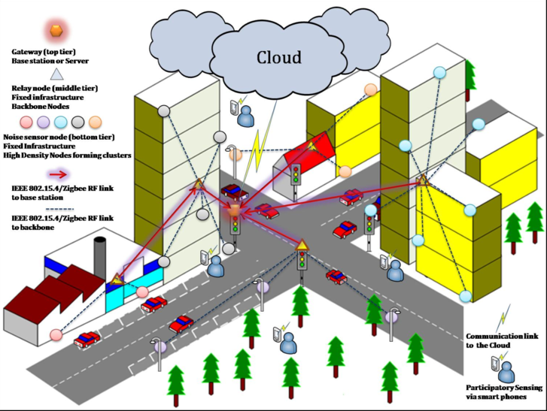
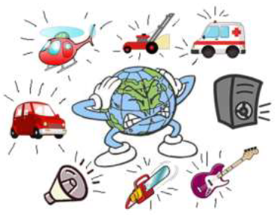
IoT – Level 4 Example: Noise Monitoring

Slide 14
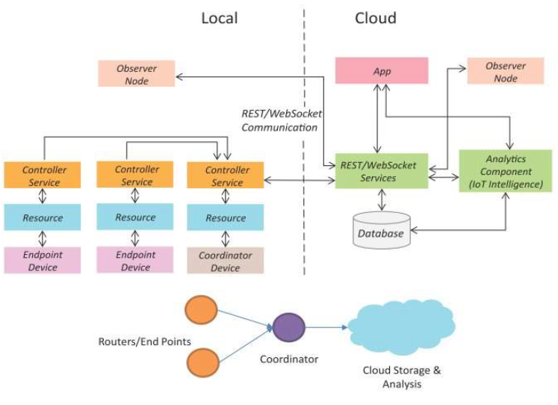
IoT Level-5
A level-5 IoT system has multiple end nodes and one coordinator node.
The end nodes perform sensing and/or actuation.
The coordinator node collects data from the end nodes and sends it to the cloud.
Data is stored and analyzed in the cloud and the application is cloud- based.
Level-5 IoT systems are suitable for solutions based on wireless sensor networks, in which the data involved is big and the analysis requirements are computationally intensive.

Slide 15
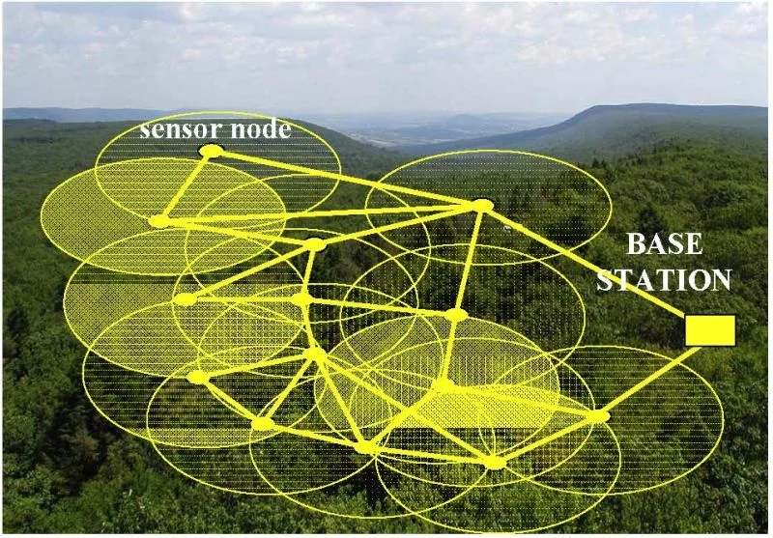
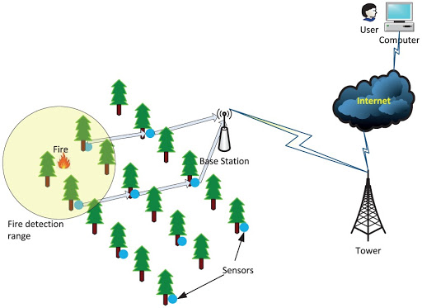
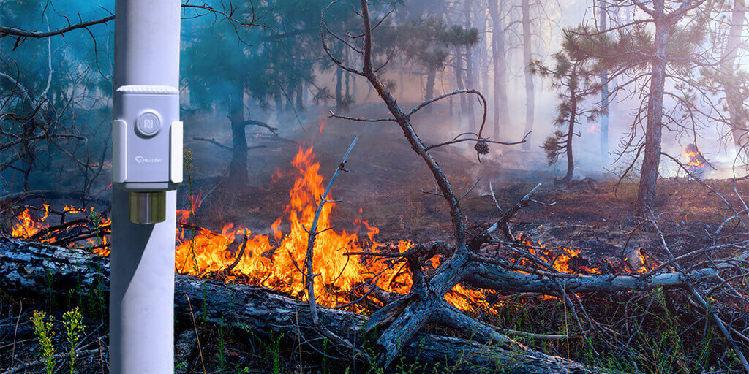
IoT – Level 5 Example: Forest Fire Detection
Sensors measure the temperature, smoke, weather, slope of the earth, wind speed, speed of fire spread, flame length

Slide 16
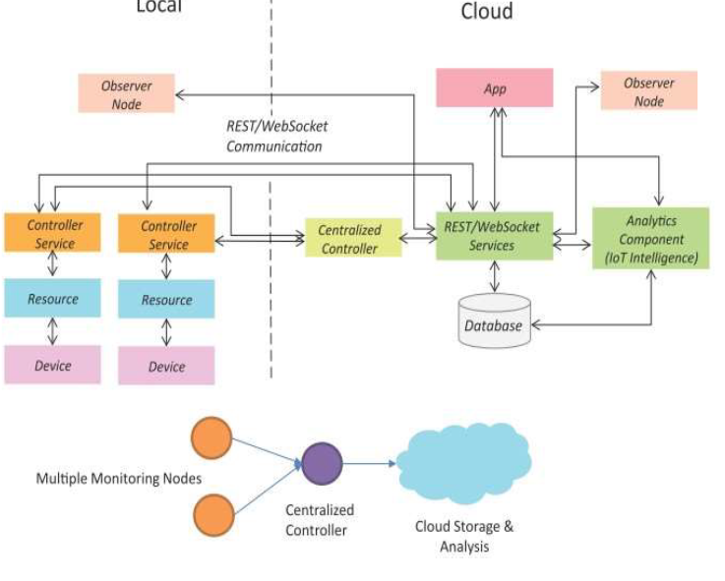
IoT Level-6
A level-6 IoT system has multiple independent end nodes that perform sensing and/or actuation and send data to the cloud.
Data is stored in the cloud and the application is cloud-based.
The analytics component analyzes the data and stores the results in the cloud database.
The results are visualized with the cloud-based application.
The centralized controller is aware of the status of all the end nodes and sends control commands to the nodes.

Slide 17
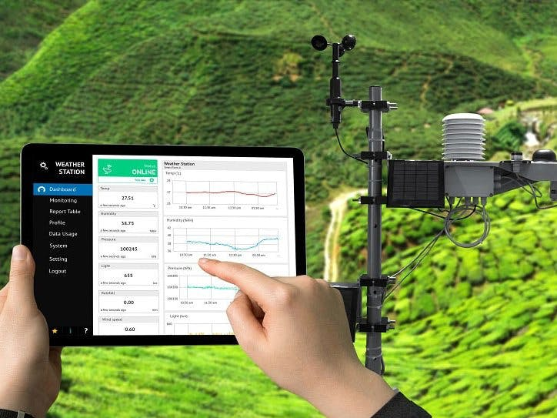
IoT – Level 6 Example:Weather Monitoring System
Sensors used
Wind speed and direction
Solar radiation
Temperature (air, water, soil)
Relative humidity
Precipitation
Snow depth
Barometric pressure
Soil moisture

Slide 18
Thank You

